Slide 1
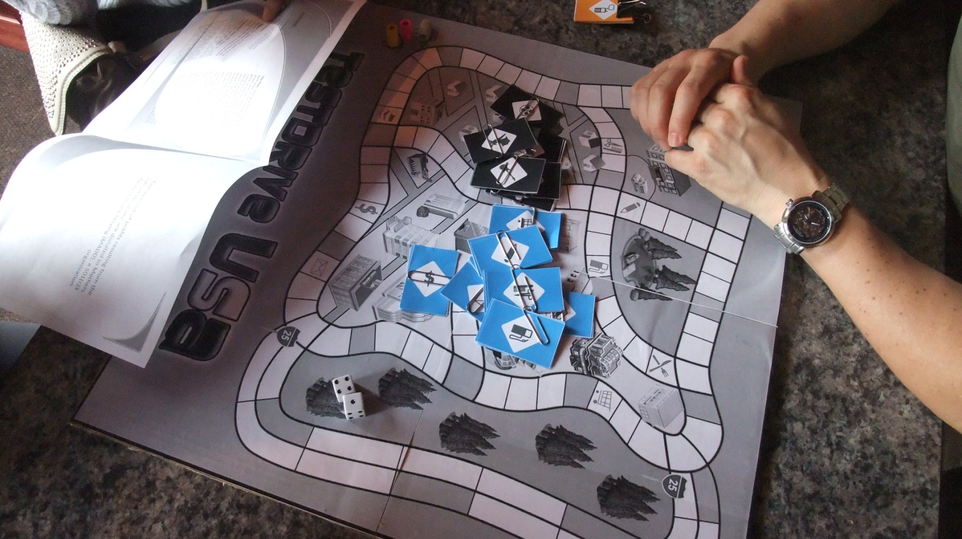
Testdrive USA
Physical Prototype & Playtest Report
By: Joy Hopkins

Slide 2
CONTENTS
Serious Goals
Target Audience
Playtest Questions
Physical Prototype
Playtester Description
Playtest Results
Testdrive USA 2.0

Slide 3
What are the game’s serious goals?
The main goal of Testdrive USA is to teach players how to drive safely. This includes:
  abiding by speed limits and other road signs
  wearing seatbelts
  understanding alcohol limits
  using cell phones appropriately
  signaling and turning properly
  understanding child restraints
Testdrive USA’s board game platform also aims to encourage open communication about safe driving between new drivers and their friends and family

Slide 4
Who is the target audience?
Testdrive USA’s target player audience consists of 14- to 18- year-olds applying for their first driver's license and their families
Testdrive USA advertisements will be targeted to teens, their families, and educators via the following channels:
  DMV offices (online & in office)
  Drivers Education schools (online & in office)
  Organizations dedicated to safe driving, including:
  MADD,
  Stop Texts Stop Wrecks
  The National Air Bag & Seat Belt Safety Campaign
Notes:
References:
http://en.wikipedia.org/wiki/Driver's_license_in_the_United_States
South DakotaDepartment of Public Safety^{[77]}No14 years14 years, 3 months (with driver's education, otherwise 14 years, six months)16 years5 yearsLearner can either take driver training and hold permit for three months or not take the course and hold permit for six months. Under 16 may not drive from 10 p.m. to 3 a.m.

Slide 5
Playtest Questions
Is the game playable?
  If not, what gaps need to be addressed?
Is the game relevant for teenagers and their families?
Are the serious goals met?
  Does Testdrive USA teach players how to drive safely?
  Does the game foster healthy discussion about safe driving?

Slide 6
Physical Prototype –
Board Design
Double-sided board game was designed to help players to demonstrate mastery of key driving skills as they navigate through a real city be it day (side A) or night (side B).
Players can choose 1 from among 6 tokens modeled after cars, each a different color.
The game board features several test drive environments, through which players must navigate successfully in order to win. The board contains a highway, four-way intersection, school zone, residential and commercial areas.

Slide 7
Physical Prototype – Cards
Players win Testdrive USA by being the first to collect all 8 errand cards on either side of the board game.
Condition cards introduce a wide range of driving conditions such as fog, rain, snow, texting, cell phone use, speeding, tailgating, car seat use, alcohol and other drug use, air bag deployment, accidents, etc.
Condition card squares are incorporated on the board to mimic varied road conditions and real-life scenarios. Players land on a condition square and must pick a condition card.

Slide 8
Playtester Description
Playtesters included 1 Teenager, 1 Mom, and 1 Friend
Game play lasted 27 minutes
Playtest environment was at a café at table that sat 4 people
Provided game rules booklet, game board, cards, tokens, and dice and then game on!

Slide 9
Playtest Results
Directions difficult for teenagers to follow, but game is playable.
  See quote from Teenager 1
Design may be attractive to teenagers and their families, but game play is way too basic
Game did not teach players how to drive and did not result in healthy conversation about safe driving
  Took 8 mins of game play to get to 1st condition card
  See quote from Mom 1
Unintended result was that game tests players ability to count
  Played more like Candy Land than a more mature game geared towards teenagers and families
  See quote from Friend 1

Slide 10
Testdrive USA 2.0
Need to find a way to make the game play more relevant and challenging for teenagers:
  Double the amount of condition card spots on the game board to make game more relevant
  Make each condition card meaningful (e.g. doesn’t matter if plus 2 or minus 2, but will matter if players can earn an errand card or need to go home)
  Only allow players to make u-turns at intersection squares to make game more challenging
Need to clarify directions by labeling cards and board:
  Label errand cards and condition cards for clarity
  Draw arrows on board to indicate that players can go in whichever direction they choose

Slide 11
Back-up

Slide 12
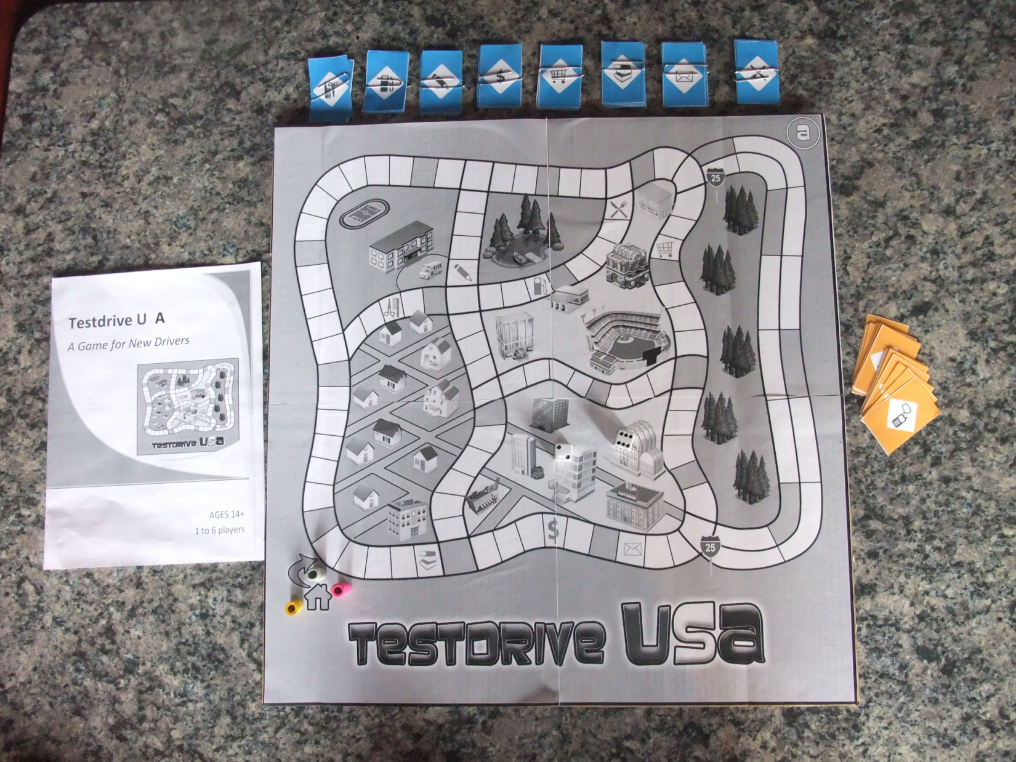
Back to last slide
Imagine the board blue. Prototype is in black and white only.
Notice the blue errand cards.
Side A: Day

Slide 13
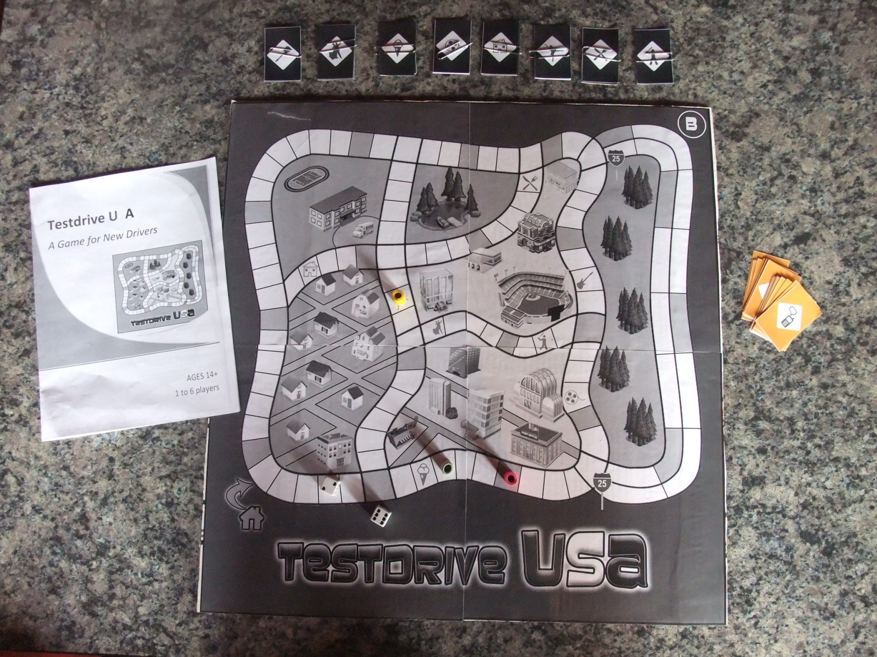
Notice the dark gray errand cards.
Side B: Night

Slide 14
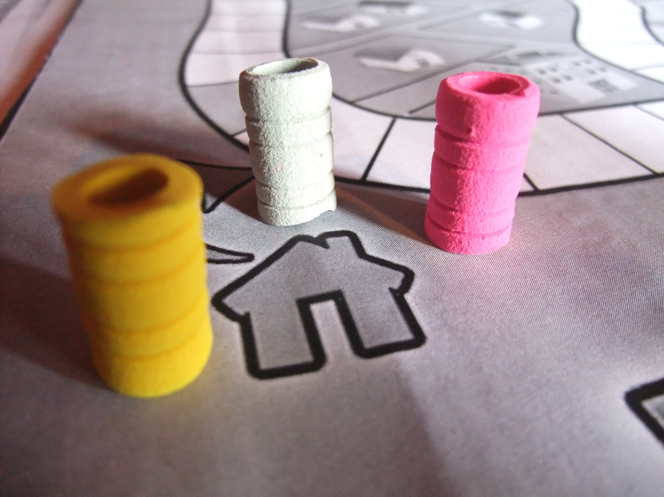
Tokens
Imagine these tokens are cars. We had 3 players during the playtesting, so hence the 3 tokens.

Slide 15
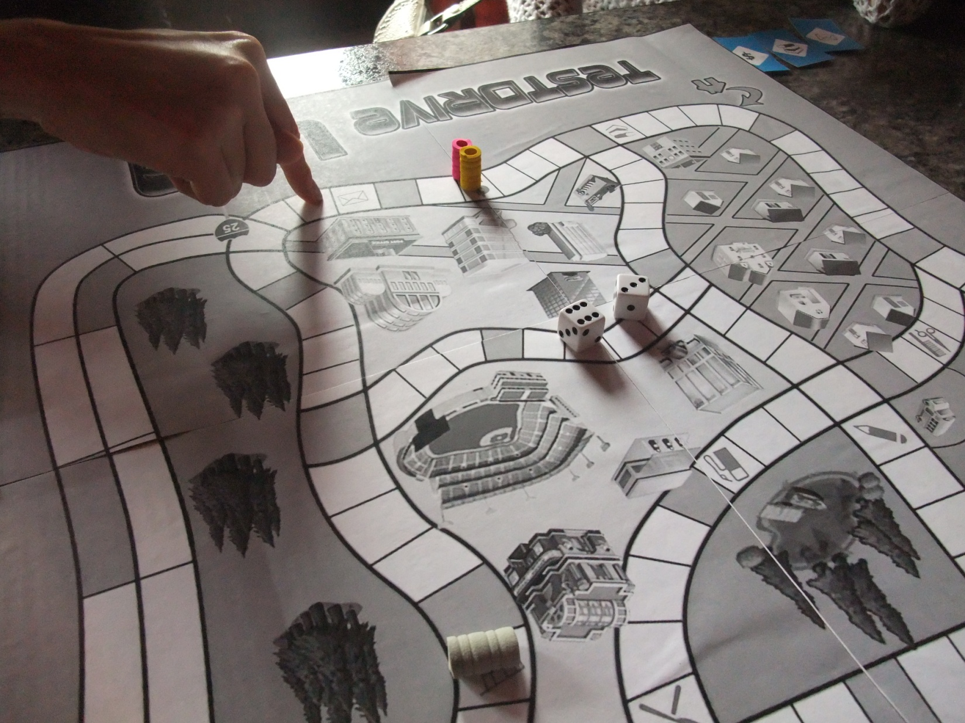
Residential
Commercial
Test Drive Environments
4-way
Highway
School

Slide 16
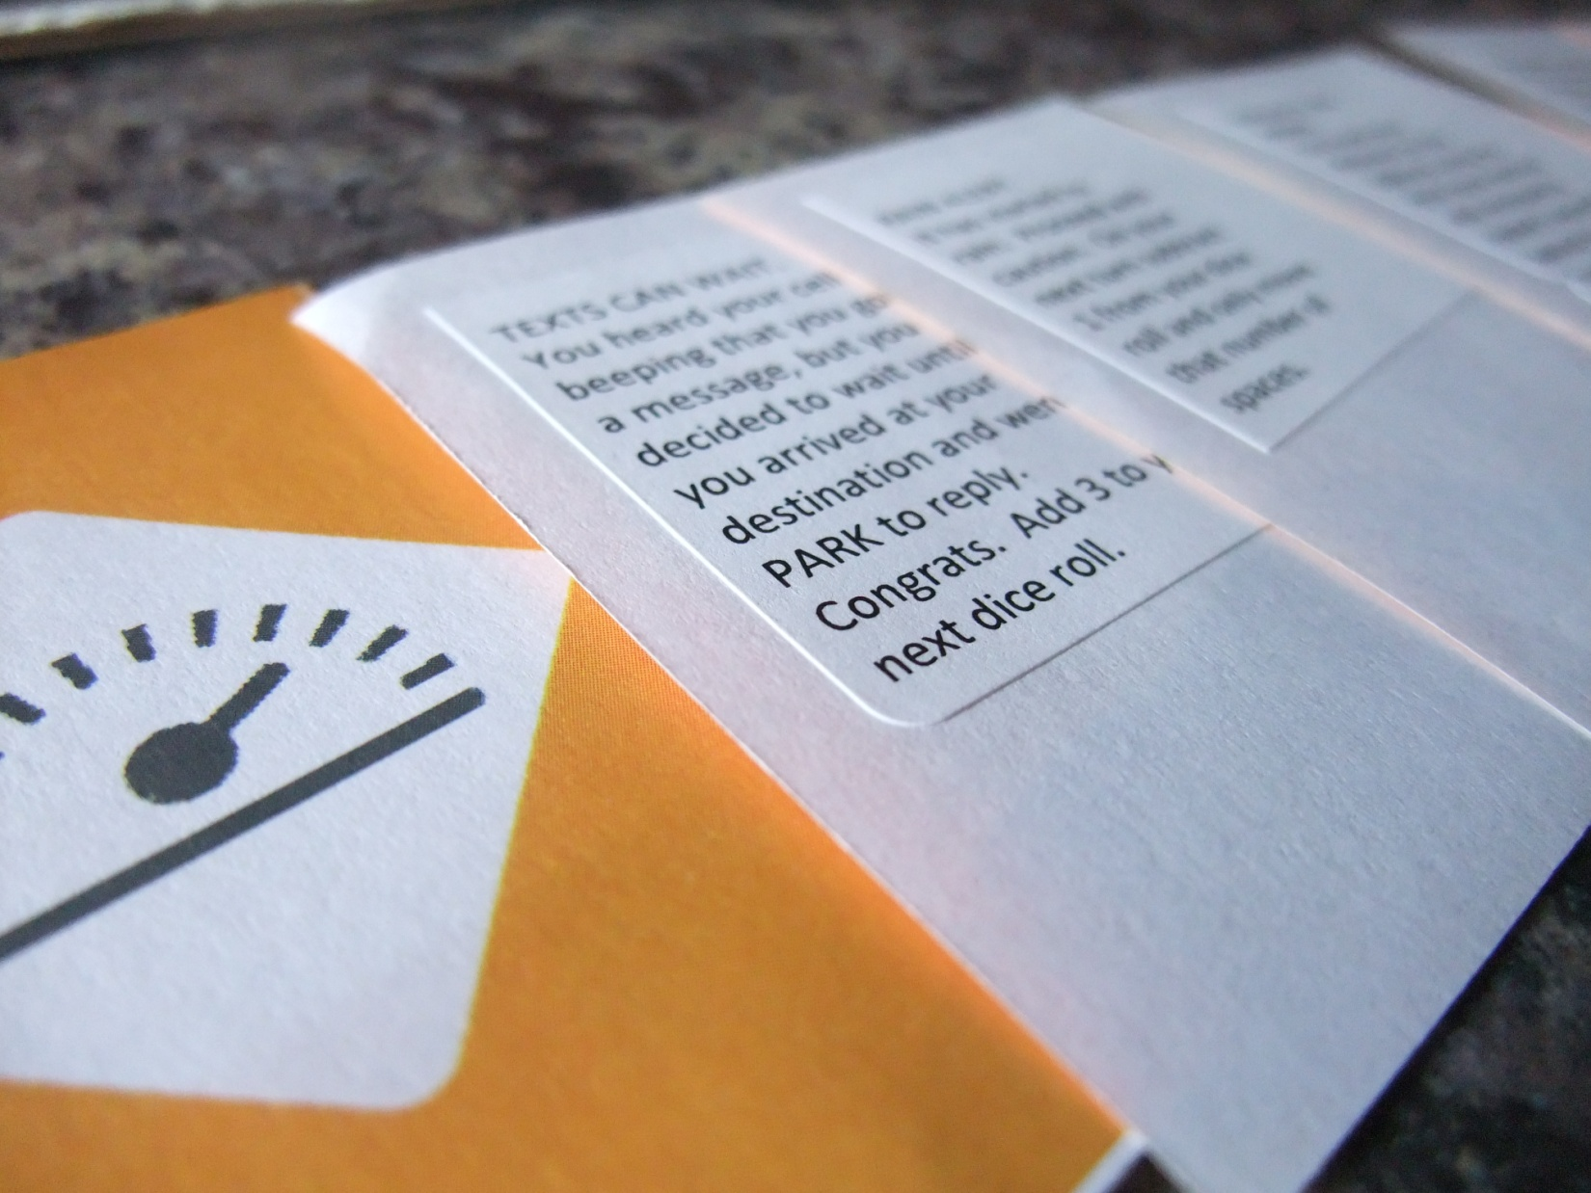
Condition Cards

Slide 17
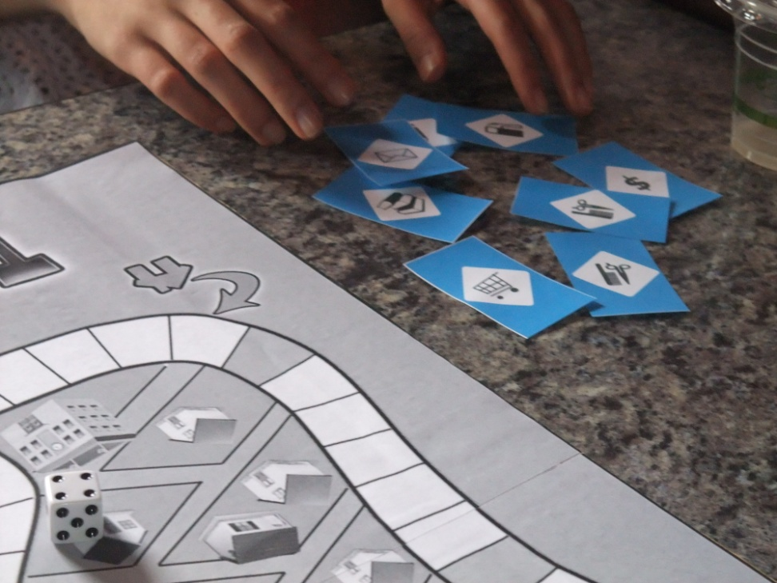
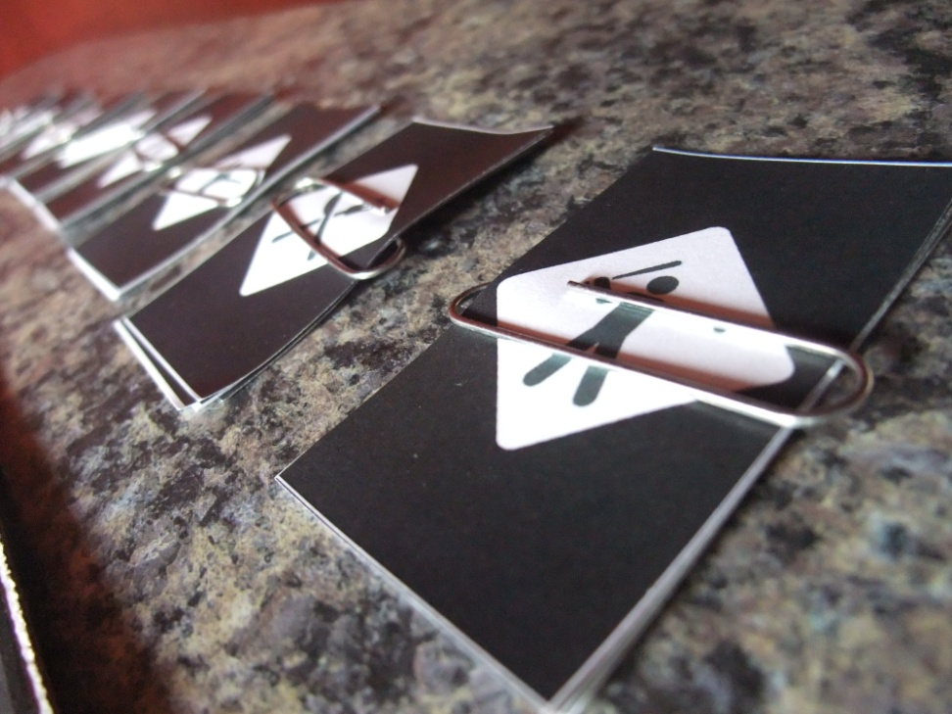
Errand cards

Slide 18
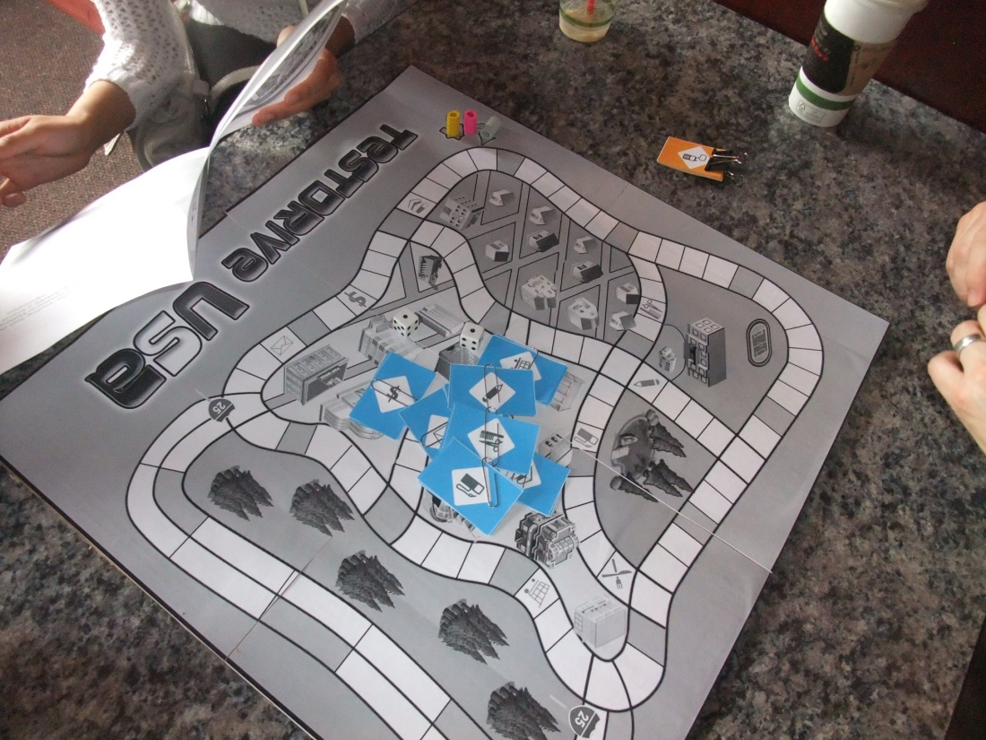
“In general, I don’t like reading instructions.” – Teenager 1

Slide 19
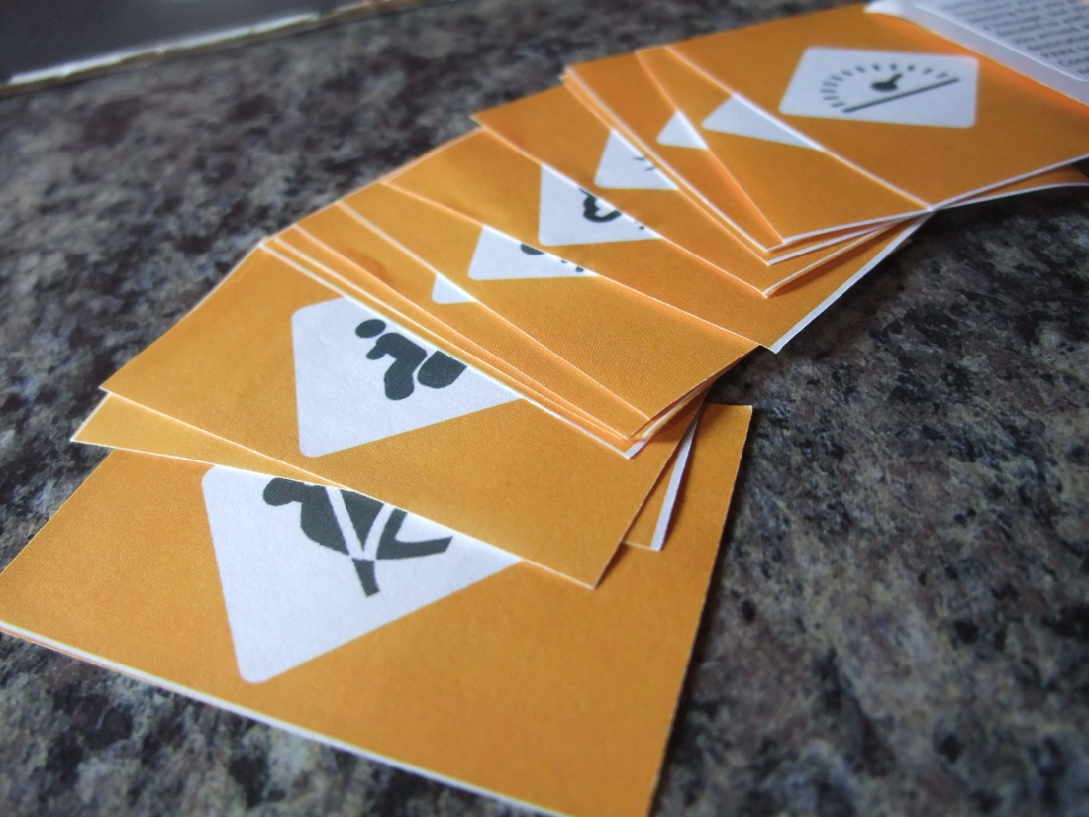
“I had fun, but we didn’t learn much about driving. You need more condition squares, because we only got to a few of those cards!” – Mom 1

Slide 20
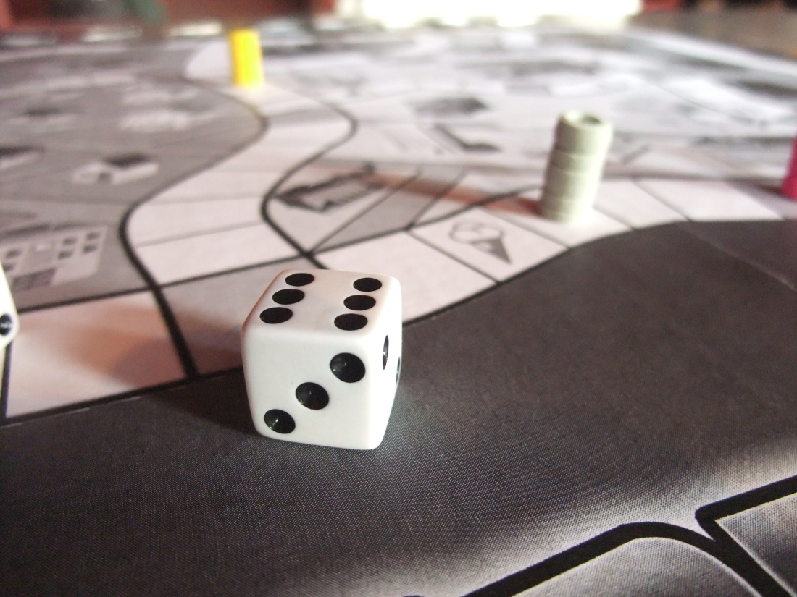
“I hate to break it to you, because I really like the design and concept, but this feels more like a counting game.” – Friend 1

Slide 21
Game Rules

